Slide 1
Understanding Activation Functions in Deep Learning
A Practical Tutorial on ReLU, Leaky ReLU, and ELU with Fashion-MNIST

Slide 2
Author | Md Shahedur Rahman
StudentID | 23036883
Course Module | Machine Learning and Neural Networks
Assignment | Individual assignment: Machine learning tutorial

Slide 3
Tutorial Outline
Introduction
Dataset Preparation
Building Models with Different Activation Functions
Training and Comparing Models

Slide 4
Tutorial Outline
Advanced Visualization: Decision Boundaries
Observations and Insights
Conclusion
References

Slide 5
Introduction
What Are Activation Functions?
Activation functions introduce non-linearity into neural networks, enabling them to learn complex patterns (Goodfellow et al., 2016).
They determine how input signals are transformed into output signals at each layer of the network.

Slide 6
Introduction
Why Are Activation Functions Crucial in Deep Learning?
Enable networks to approximate non-linear relationships between input and output.
Allow stacking of multiple layers to form deep architectures.
Examples of activation functions:
ReLU: Simplicity and efficiency.
Leaky ReLU: Gradient flow improvements.
ELU: Smooth convergence for deeper models.

Slide 7
Understanding Activation Functions
ReLU: The Most Widely Used Activation Function
Definition:
Rectified Linear Unit (ReLU) is defined as:
f(x) = max(0, x)
Introduced in the context of deep learning to improve gradient flow and computational efficiency (He et al., 2015).
Advantages:
Computational efficiency.
Introduces sparsity into activations.
Limitations:
Dying ReLU problem: Neurons become inactive for negative inputs.

Slide 8
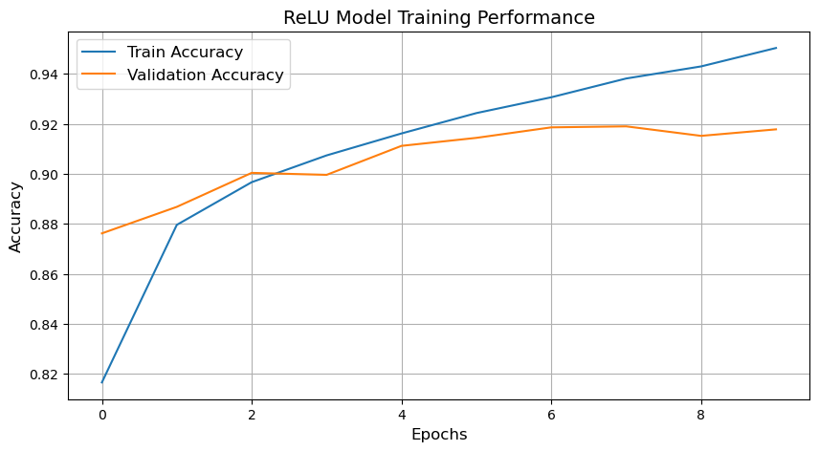
Understanding Activation Functions
ReLU: The Most Widely Used Activation Function

Slide 9
Understanding Activation Functions
Leaky ReLU: Addressing the "Dying ReLU" Problem
Definition:
Leaky ReLU allows a small gradient for negative inputs: f(x)=x if x>0,
otherwise f(x)=αx, where α is a small positive constant (Maas et al., 2013).
Advantages:
Resolves the dying ReLU issue by allowing gradient flow for negative inputs.
Limitations:
The small slope in negative regions can still result in slow training in some cases.

Slide 10
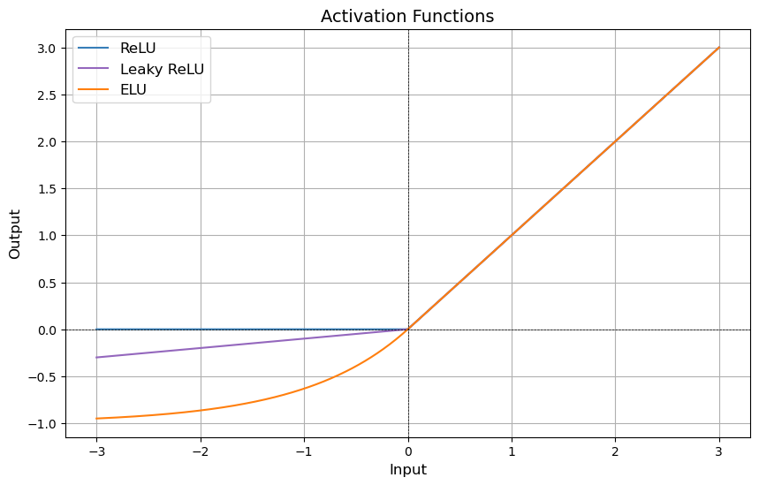
Understanding Activation Functions
Leaky ReLU: Addressing the "Dying ReLU" Problem

Slide 11
Understanding Activation Functions
ELU: Smoothing Convergence for Deep Networks
Definition:
ELU (Exponential Linear Unit) outputs: f(x)=x if x>0,
otherwise f(x)=α(exp⁡(x)−1) (Clevert et al., 2015).
Advantages:
Smooth transition between negative and positive inputs improves optimization.
Limitations:
Slightly more computationally expensive due to the exponential operation.

Slide 12
Understanding Activation Functions
ELU: Smoothing Convergence for Deep Networks

Slide 13
Dataset Preparation
Introduction to the Fashion-MNIST Dataset
Fashion-MNIST:
A dataset of 70,000 grayscale images of fashion items, split into 10 classes (e.g., shirts, shoes) (Xiao et al., 2017).
Challenges: Diverse and ambiguous patterns, making it ideal for testing neural networks.

Slide 14
Dataset Preparation
Data Preprocessing Steps
Normalize pixel values to a range of [0, 1].
Add a channel dimension for compatibility with Conv2D layers.
Split into training, validation, and test sets.

Slide 15
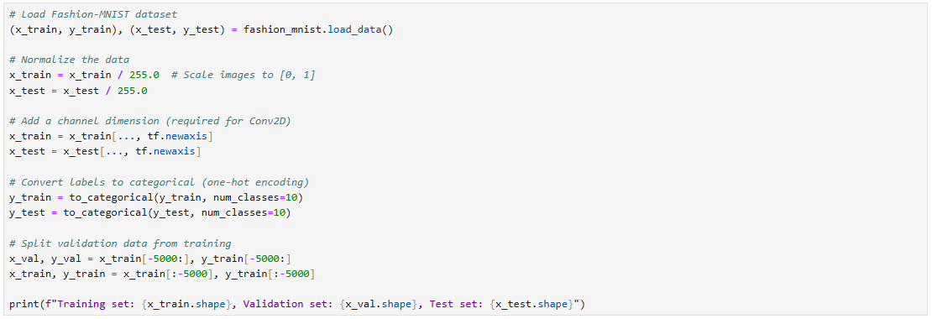
Dataset Preparation
Data Preprocessing Steps

Slide 16
Building Models with Different Activation Functions
Model Architecture for ReLU
A simple convolutional neural network with:
2 Conv2D layers using ReLU activation.
2 MaxPooling2D layers for downsampling.
1 Dense layer with 128 units and ReLU.
A final Dense layer with softmax for classification.

Slide 17
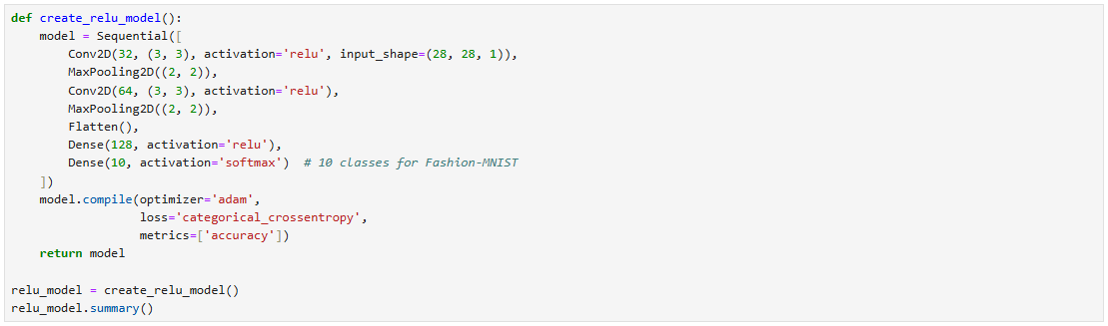
Building Models with Different Activation Functions
Model Architecture for ReLU

Slide 18
Building Models with Different Activation Functions
Model Architecture for Leaky ReLU
Similar to the ReLU model but replaces ReLU with Leaky ReLU:
Conv2D layers with Leaky ReLU activation (alpha=0.1).
Dense layers with Leaky ReLU activation.

Slide 19
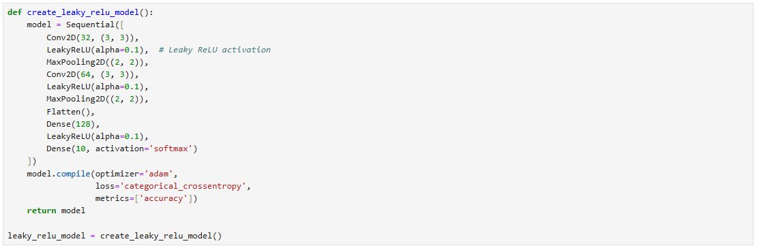
Building Models with Different Activation Functions
Model Architecture for Leaky ReLU

Slide 20
Building Models with Different Activation Functions
Model Architecture for ELU
Similar to the previous models but replaces activation functions with ELU:
Conv2D layers with ELU activation.
Dense layers with ELU activation for smooth gradients.

Slide 21
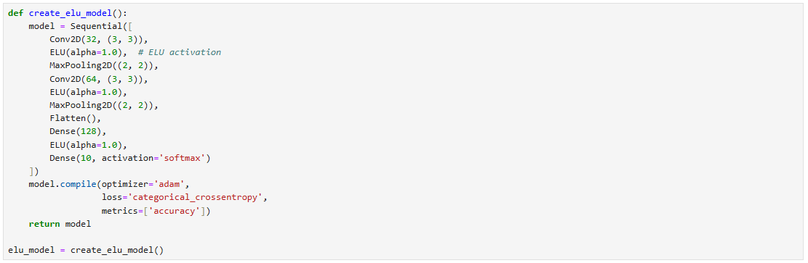
Building Models with Different Activation Functions
Model Architecture for ELU

Slide 22
Training Models with Different Activation Functions
Training Parameters:
Optimizer: Adam
Loss Function: Categorical Crossentropy
Batch Size: 64
Epochs: 10
Trained models:
ReLU Model
Leaky ReLU Model
ELU Model

Slide 23
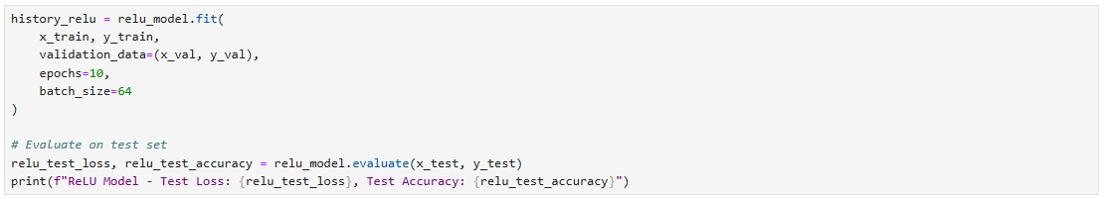
Training Models with Different Activation Functions

Slide 24
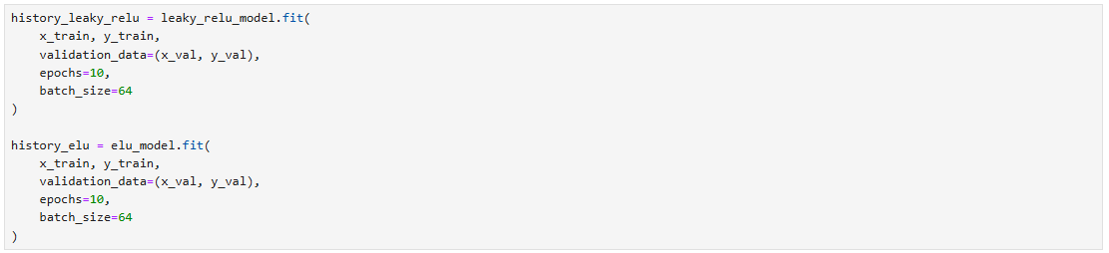
Training Models with Different Activation Functions

Slide 25
Training Results
Observations:
All three models converged within 10 epochs.
Slight differences in validation loss and accuracy, depending on the activation function.

Slide 26
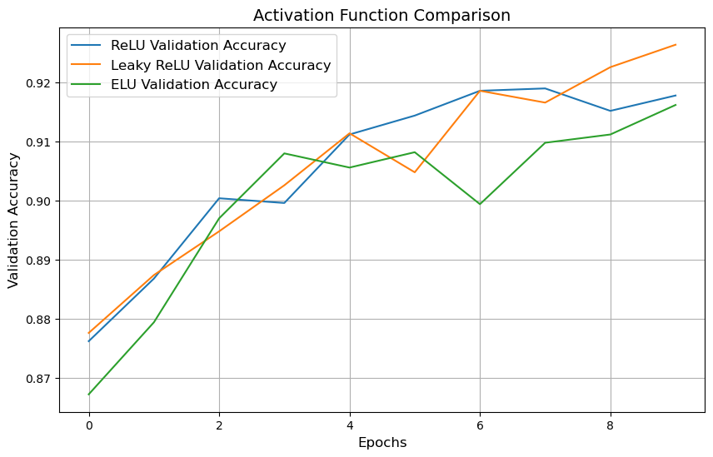
Training Results
The training and validation accuracy comparison plot

Slide 27
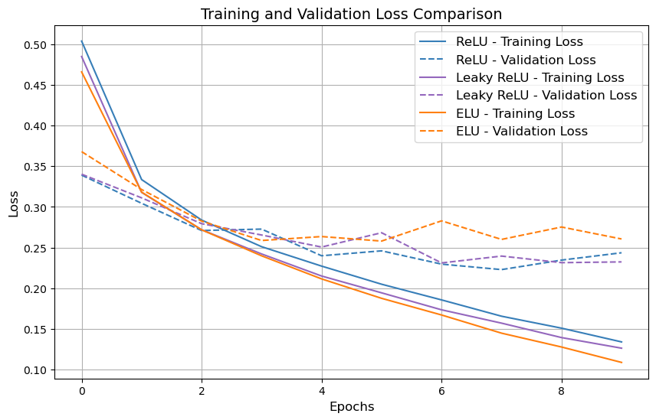
Training Results
The training and validation loss comparison plot

Slide 28
Decision Boundaries
Visualizing Decision Boundaries
Decision boundaries illustrate how models classify data in input space.
Differences in boundary smoothness reflect the activation functions used.

Slide 29
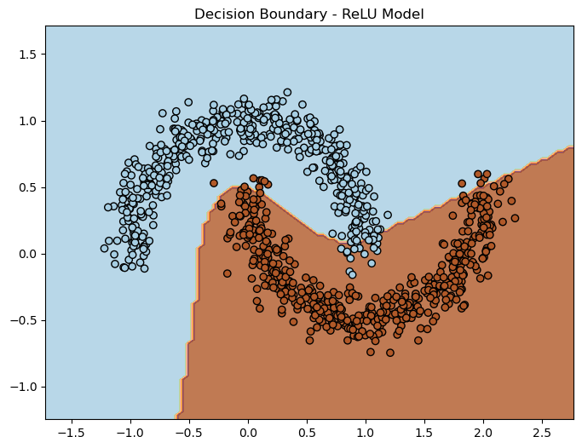
Decision Boundaries
Visualizing Decision Boundaries

Slide 30
Observations and Insights
Performance Comparison:
ReLU:
Fast convergence but prone to dying ReLU for deeper layers.
Leaky ReLU:
Improved gradient flow but slower convergence.
ELU:
Smooth convergence but higher computational cost.

Slide 31
Observations and Insights
Recommendations:
Use ReLU for general-purpose tasks.
Consider Leaky ReLU for avoiding dying ReLU issues.
Use ELU for deeper networks requiring smoother optimization.

Slide 32
Performance Comparison
Validation Accuracy Comparison
ReLU:
Validation accuracy stabilizes around 91% after 10 epochs.
Slight fluctuations in later epochs indicate possible overfitting.
Leaky ReLU:
Validation accuracy reaches ~92%, higher than ReLU in the later epochs.
Smoothest convergence with reduced overfitting tendencies.
ELU:
Validation accuracy starts lower than ReLU and Leaky ReLU but catches up to reach around 91%.
Demonstrates smooth convergence but slightly lags in early epochs.

Slide 33
Performance Comparison
Validation Accuracy Comparison

Slide 34
Key Insights
When to Use Each Activation Function:
ReLU: Best for shallow or moderately deep networks.
Leaky ReLU: Use when avoiding the "dying ReLU" problem.
ELU: Ideal for deep networks requiring smoother optimization.
Considerations:
Computational cost increases from ReLU to ELU.
Choice of activation can significantly impact training dynamics and accuracy.

Slide 35
Conclusion
Activation functions are crucial for introducing non-linearity in neural networks.
Each activation function (ReLU, Leaky ReLU, ELU) has distinct advantages and trade-offs.
Optimal selection depends on:
Network depth.
Task complexity.
Desired computational efficiency.

Slide 36
Reference lists
Goodfellow, I., Bengio, Y., and Courville, A. (2016). Deep Learning. MIT Press.
Maas, A.L., Hannun, A.Y., and Ng, A.Y. (2013). Rectifier Nonlinearities Improve Neural Network Acoustic Models. Proceedings of ICML.
Clevert, D.-A., Unterthiner, T., and Hochreiter, S. (2015). Fast and Accurate Deep Network Learning by Exponential Linear Units (ELUs). arXiv:1511.07289.
Xiao, H., Rasul, K., and Vollgraf, R. (2017). Fashion-MNIST: A Novel Image Dataset for Benchmarking Machine Learning Algorithms. arXiv:1708.07747.
He, K., Zhang, X., Ren, S., and Sun, J. (2015). Delving Deep into Rectifiers: Surpassing Human-Level Performance on ImageNet Classification. arXiv:1502.01852.

